Slide 1
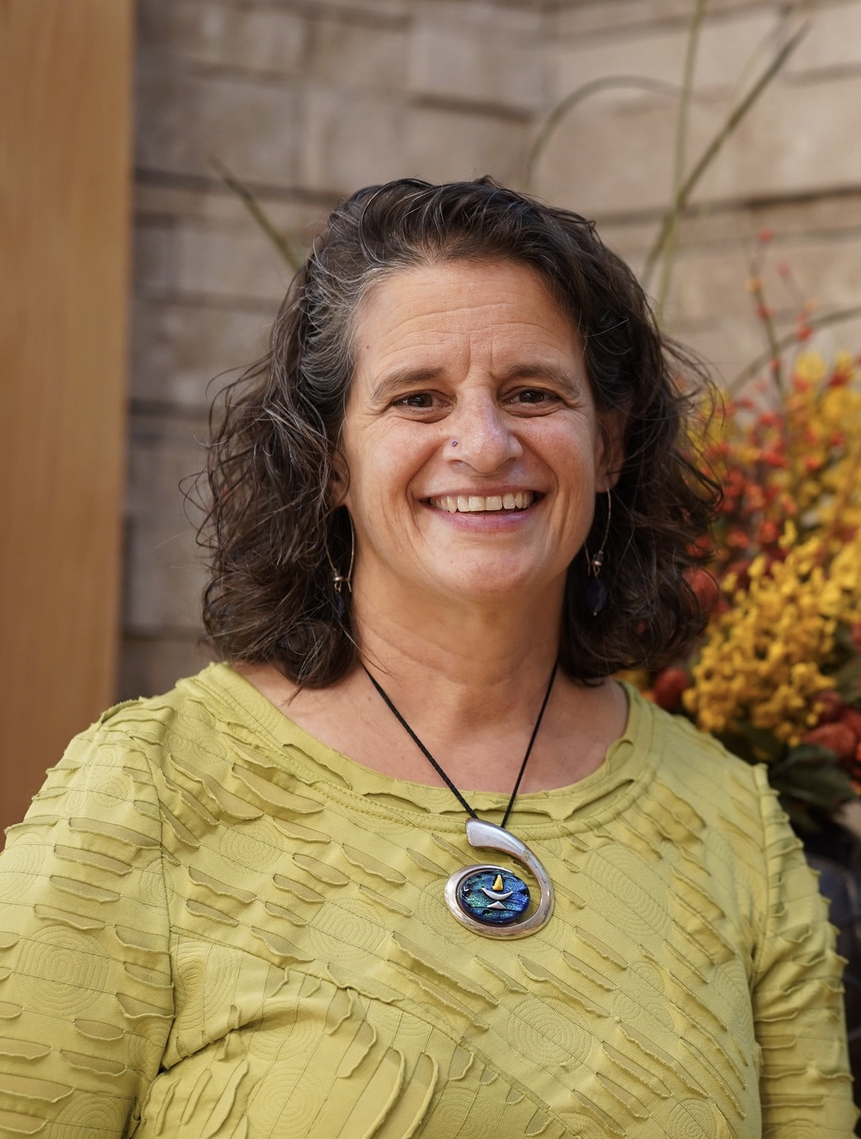
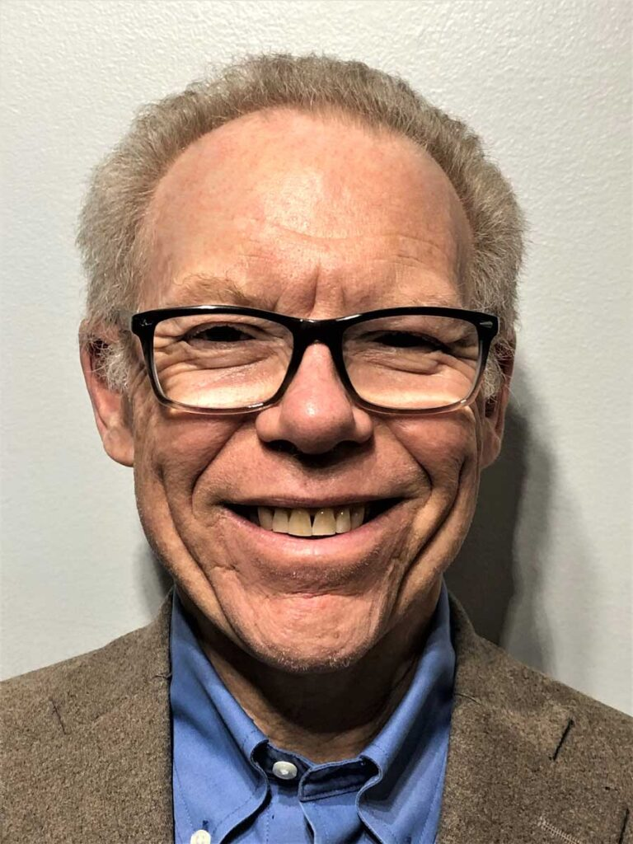
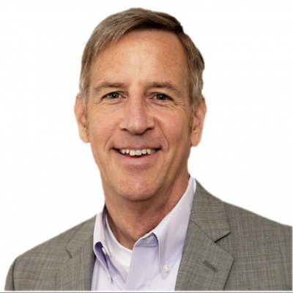
Stewardship Friday Forum
Campaign Celebration and Lessons Learned
Mark Ewert and Barry Finkelstein
and Rev. Lydia Ferrante-Roseberry
May 31, 2024

